Slide 1




Basic Details of the Team and Problem Statement
Ministry/Organization Name/Student Innovation:
AICTE, MIC - Student Innovation
PS Code: 1468 Problem Statement Title: Awareness and Preparedness Towards Disaster Management Team Name: Fluke
Team Leader Name: Samayank Goel
Institute Code (AISHE): C-49441
Institute Name: Vellore Institute of Technology, Chennai
Theme Name: Disaster Management, Risk Mitigation and Planning

Slide 2
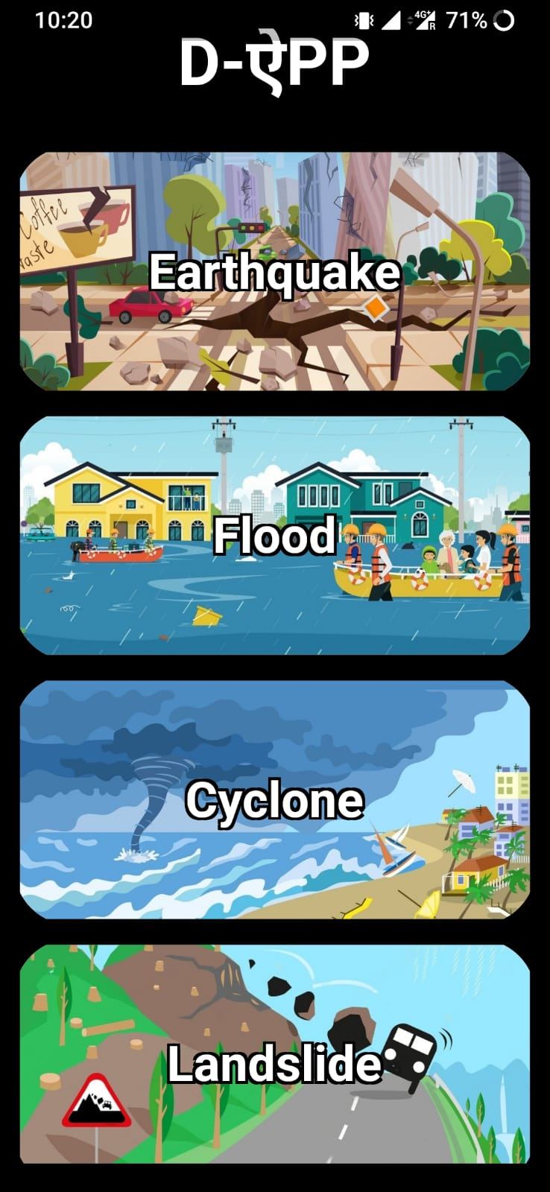
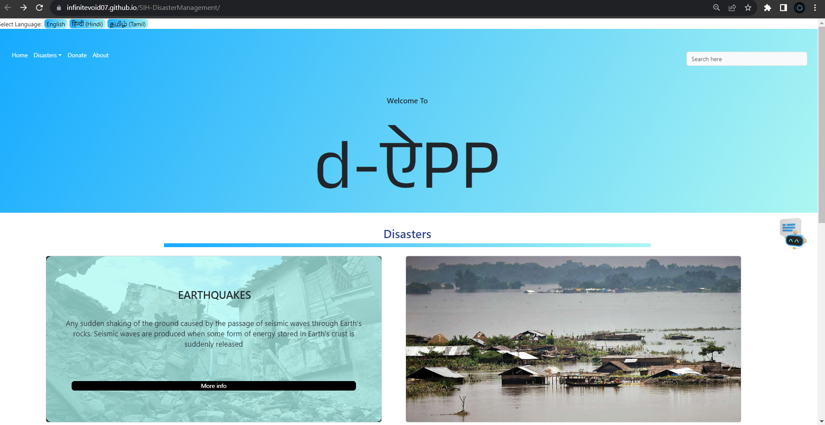

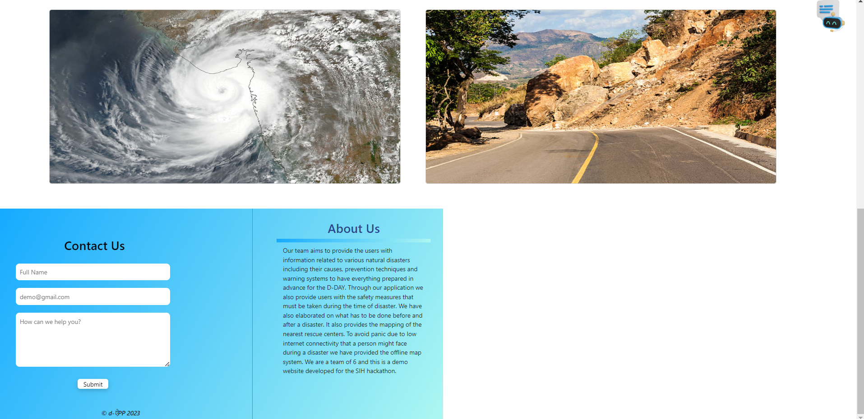
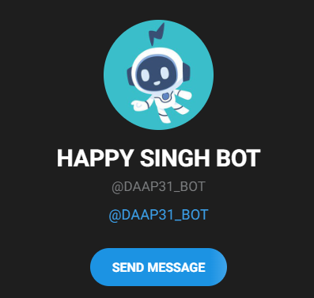









Idea/Approach Details
Idea/Solution: -
Implement a comprehensive disaster management system, consisting of an offline app, a website, and a chatbot.
Generating awareness about various types of disasters.
Amass a wealth of disaster-related resources, from basic information to real-time alerts, all in one accessible platform.
Generate a map of nearby emergency shelters and emergency helpline number.
Encourage community engagement by facilitating communication and assistance through forums.
Reduce the impact of disasters on people and property.
Provide access to critical disaster information, even without internet, and receive assistance during disasters.
Technology stack: -

Slide 3
Idea/Approach Details
Use Cases: -
Dependencies / Show stopper: -
Comprehensive Resources: Access a one-stop hub for disaster info and resources.
Offline Access: Use the app without internet for crucial info.
Immediate Help: Find rescue helplines quickly during disasters.
Interactive Map: Enable users to interact with the map to access detailed information.
Multilingual Info: Get detailed disaster info in multiple languages on the website.
Real-time Alerts: Receive instant disaster alerts and early warnings for upcoming disasters.
Community Support: Participate in forums for disaster-related help.
User-Friendly Design: Ensure an easy-to-use interface for all users.
Dependencies: -
Reliable sources of real-time disaster data and information
Offline app requires a mobile device with the app installed.
Website requires an internet connection and a web browser.
Chatbot requires an internet connection to provide real-time information.
API and services.
Show Stoppers: -
Offline app with comprehensive details about disasters.
Multilingual Support, Real-Time Alerts.
Empowering Individuals by providing knowledge.

Slide 4
Team Member Details
Apk file-> https://github.com/InfiniteVoid07/SIH-DisasterManagement/tree/master
Website -> infinitevoid07.github.io/SIH-DisasterManagement/
Chatbot -> https://t.me/DAAP31_BOT
Team Leader Name: Samayank Goel
Branch (Btech/Mtech/PhD etc): Btech Stream (ECE, CSE etc): CSE Year (I,II,III,IV): II
Team Member 1 Name: Harshit Chaudhary
Branch (Btech/Mtech/PhD etc): Btech Stream (ECE, CSE etc): CSE Year (I,II,III,IV): II
Team Member 2 Name: Sanyam Jindal
Branch (Btech/Mtech/PhD etc): Btech Stream (ECE, CSE etc): CSE Year (I,II,III,IV): II
Team Member 3 Name: Simarpreet Singh
Branch (Btech/Mtech/PhD etc): Btech Stream (ECE, CSE etc): CSE Year (I,II,III,IV): II
Team Member 4 Name: Priyansh Shah
Branch (Btech/Mtech/PhD etc): Btech Stream (ECE, CSE etc): CSE Year (I,II,III,IV): II
Team Member 5 Name: Niyanta Patibandha
Branch (Btech/Mtech/PhD etc): Btech Stream (ECE, CSE etc): CSE Year (I,II,III,IV): II
Team Mentor 1 Name: Dr Amutha S
Category (Academic/Industry): Academic Expertise (AI/ML/Blockchain etc): ML Domain Experience (in years): 7
Team Mentor 2 Name: Dr Bhuvaneshwari Amma N. G.
Category (Academic/Industry): Academic Expertise (AI/ML/Blockchain etc): ML Domain Experience (in years): 7

